Slide 1
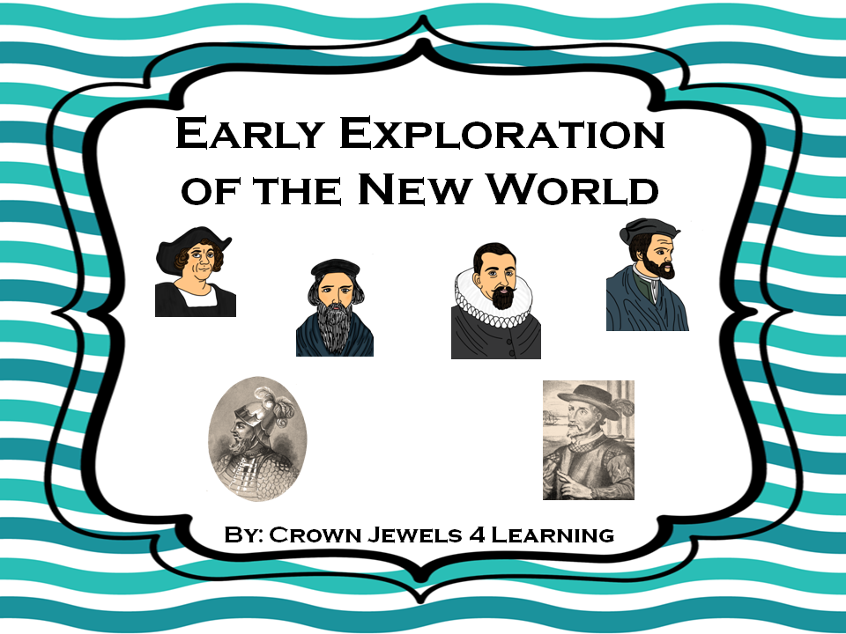

Slide 2
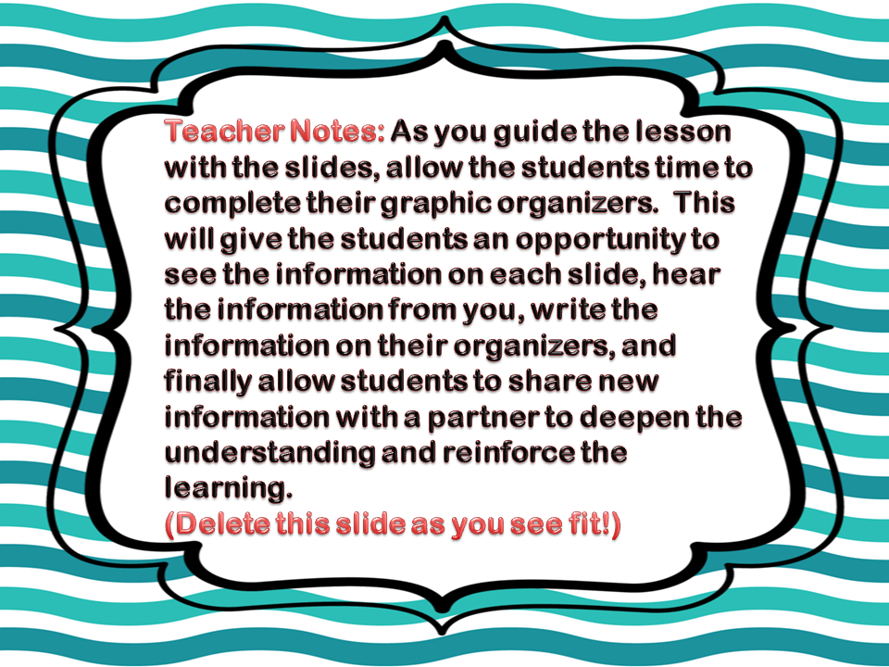

Slide 3

Why did they explore?
Most European countries explored for three reasons.
    Riches- They searched for gold, land,
and resources.
    Religion- They shared Christianity with
other lands.
    Reputation- They were thrill seekers who
wanted to become famous.

Slide 4

What obstacles did they encounter?
Exploring was not as easy as it sounds!
  Maps- They were exploring places people had never been. They had no maps.
  Weather- Weather often caused rough seas, extreme cold, or heat and made their voyages difficult.
  Supplies- They often ran out of supplies during their expeditions.
  Diseases- They were exposed to diseases from insects.
  Fear- Crew members were afraid of leaving their families to go to a place they had never been. Explorers often didn’t have all the crew members they needed for their journeys.
  Enemies- They often encountered Natives who wanted to protect their lands from anyone who might try to claim it.

Slide 5

Native Americans…
They were here first!
When explorers arrived in North America, they found people already occupying the land. Their encounters were sometimes helpful and other times they were harmful!

Slide 6

The following slides will show ways the explorers and Native Americans interacted. Determine if the contact was helpful or harmful.

Slide 7
They shared things like weapons and farming tools.
Helpful
Harmful

Slide 8

Native Americans taught them how to grow crops.
Helpful
Harmful

Slide 9

Explorers claimed land occupied by the Native Americans for their sponsor countries.
Helpful
Harmful

Slide 10

They traded goods and treasures.
Helpful
Harmful

Slide 11

They spoke different languages making it difficult to communicate.
Helpful
Harmful

Slide 12

They came from different cultures and religious backgrounds.
Helpful
Harmful

Slide 13

Outcomes of Exploration
New lands were discovered.
The expeditions of early explorers provided a new understanding of the world’s geography and improved map development and accuracy.
Trade was established between countries which boosted their economy.
Improvements in ship building and transportation occurred.

Slide 14
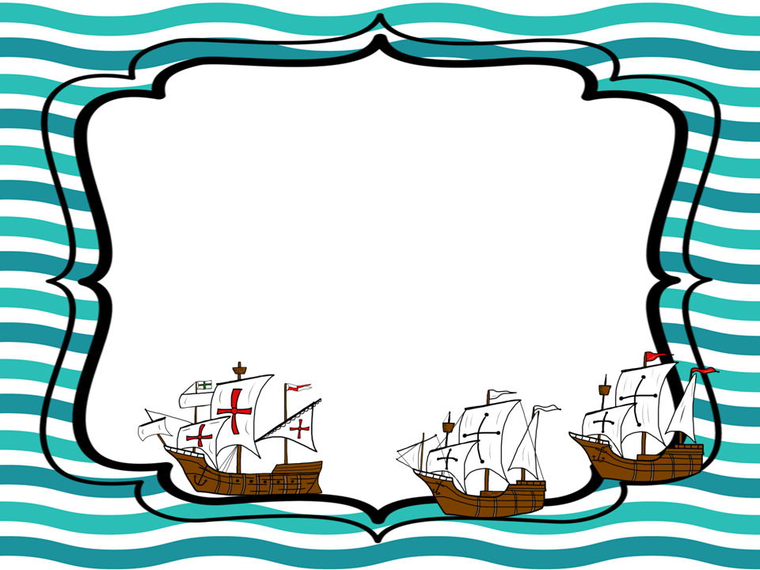
3-2-1 Review
(You may use your graphic organizer or a partner to help you!)
List 3 reasons for exploration.
____________, ____________, ___________
List 2 obstacles they encountered.
__________________, __________________
List 1 outcome of the expeditions.
_____________________________________
(Sentence)

Slide 15


